Slide 1
GOODLUCK INDUSTRIES LTD Corporate Brief Session
22nd Jan 2022

Slide 2
Contents
Introduction
Five Year Analysis
Analysis FY21 Results
Key Financial Notes
Question Answer Session

Slide 3
INTRODUCTION

Slide 4
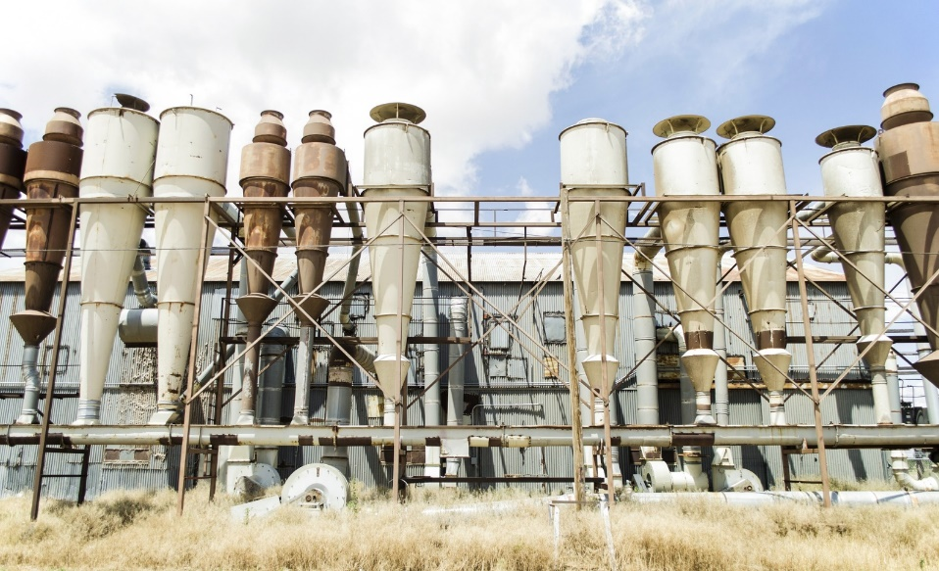
Business Description
Goodluck Industries Ltd was established in 1967. Our main line of business is milling of wheat. We hold broad knowledge in flour production and are one of the major producers of flour items such as: • Maida • Fine • Atta • Bran
Our total wheat processing capacity is approximately 257 M.T/day.

Slide 5
Board of Directors

Slide 6
FIVE YEARS ANALYSIS

Slide 7
Revenue

Slide 8
Gross Profit

Slide 9
Net Profit

Slide 10
EPS

Slide 11
Break up Value of shares

Slide 12
Analysis FY21 Results

Slide 16
Key Financial Notes

Slide 17
Accumulative sum of Rs 4 million was incurred as capital expenditure and were added in property, plant and equipment.
The board of directors of the company has proposed to declare payment of cash dividend at Rs. 3 per ordinary shares for the year ended June 30, 2021.
The board of directors specifically approved the provision for gratuity by Rs. 1.29 million during the financial year ended June 30, 2021.
The Chief Executive and Board of directors of the company have decided to forgo fees, remuneration and perquisites

Slide 18
Question & Answer

